Slide 1
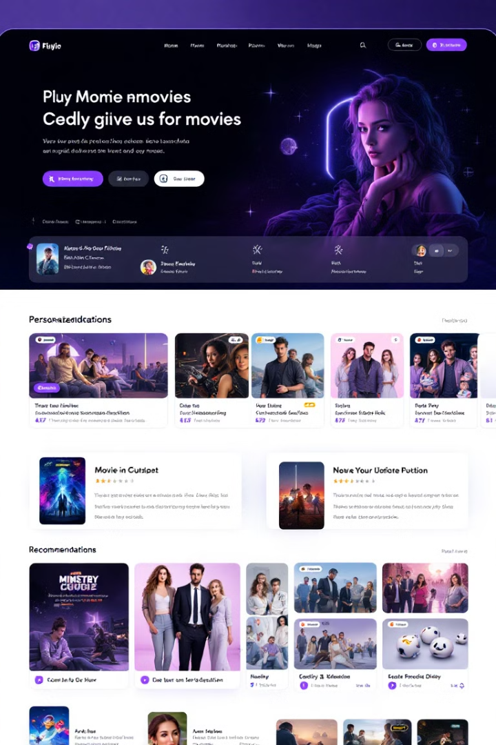
Movie Recommendation System
by
Colleta Kiilu

Slide 2

Business Understanding
This project creates a movie recommendation system. It addresses the challenge of providing personalized content. The system enhances user experience and engagement.
The Challenge: Movie streaming services face user frustration due to lack of tailored content, leading to decreased interaction and potential revenue loss.
The Solution: a recommendation system based on user ratings and preferences can improve the viewing experience.
Benefits: the system uses data-driven insights to provide tailored movie recommendations, which increases user engagement and pleasure.
Business Impact: Improves conversion rates, customer happiness, and user retention.

Slide 3

Project Objectives
1
User Engagement
2
Recommendation Diversity
Keep viewers engaged longer with tailored suggestions.
Balance familiarity with exploration of new content.
3
Content Discoverability
Showcase a broader selection of films to users.

Slide 4
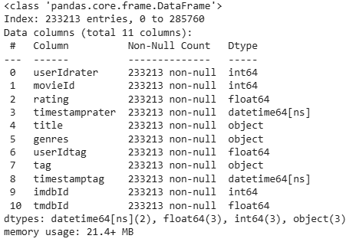
Data Understanding
The data was sourced from the popular MovieLens dataset from the GroupLens research lab at the University of Minnesota.
The different subsets (movies, ratings, links, tags) were merged.
Dataset Size
Key Features
Missing Values
285,762 rows and 11 columns initially.
userIdrater, movieId, rating, title, genres.
userIdtag, tag, timestamptag columns had missing data.
After dropping null values, 233,213 records remained.
The timestamps were also converted to datetime format.
Other data types include string, integer and float.
the data ranges from March 1996 to September 2018.

Slide 5
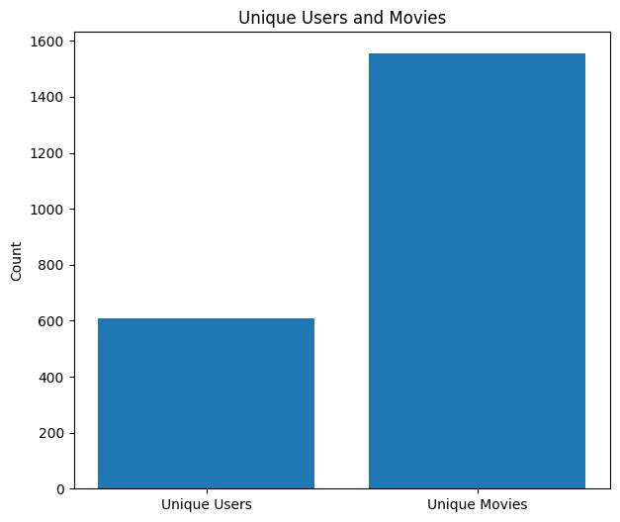
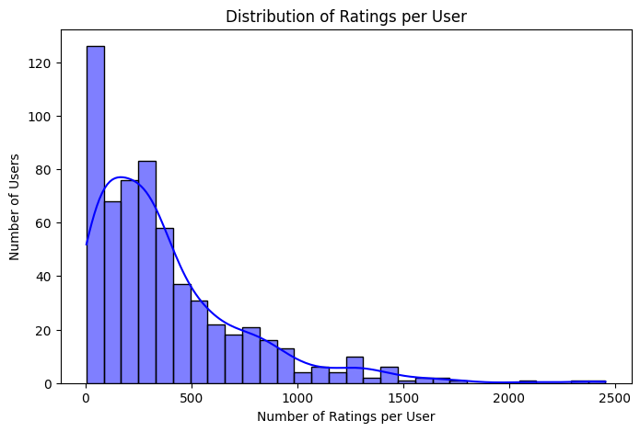
Exploratory Data Analysis (EDA)
There are 610 unique users and 1,554 unique movies.
The average number of ratings per user is 382.32., while the median is 280, indicating most users rated fewer movies than average.
The rating activity is highly skewed with a few users contributing the majority of ratings.
The most active user rated 2,455 movies, while the 10th most active user rated 1,460 movies.
The Top 10 Highest Rated Movies all had an averaging rating of 5.
Bottom 10 Lowest Rated Movies had an average rating of between 0.5 to 1.8.

Slide 6

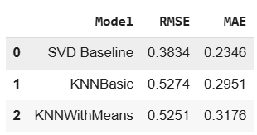
Modeling
1
Data Preparation
userIdrater, movieId, rating columns were used for the modeling data.
The surprise library was used to instantiate reader and data.
train_test_split() was used to generate the train and test datasets
2
Models Trained
Baseline - Singular Value Decomposition with basic parameters
Model 2: KNNBasic
Model 3: KNNWithMeans
3
Evaluation
A low Root Mean Squared Error (RMSE) means that a model is able to make more accurate predictions.
A low Mean Absolute Error (MAE) indicates less difference between the predicted and actual ratings

Slide 7



Tuned SVD Model
The best initial model was the basic SVD. It had an RMSE of 0.3834 and an MAE: 0.2346.
It made the best candidate for hyperparameter tuning with GridSearchCV.
Best Performance
Hyperparameter Tuning
RMSE: 0.3642
MAE: 0.2188
Improved prediction accuracy.

Slide 8



Conclusion
2
Improved Engagement
1
Personalized Suggestions
Enhanced Discoverability
3
The project developed a movie recommendation system. A tuned SVD model was most effective. It improves user engagement and content discoverability.

Slide 9
Recommendations
1
Deployment
2
Monitoring
3
Enhancement
Integrate into streaming platform. Continuously monitor performance. Add features like genre preferences.

